Slide 1
Historical Context of Priority Schools
Josh Carson & Evan Kramer | Data Governance and Accountability
Notes:
Evan

Slide 2
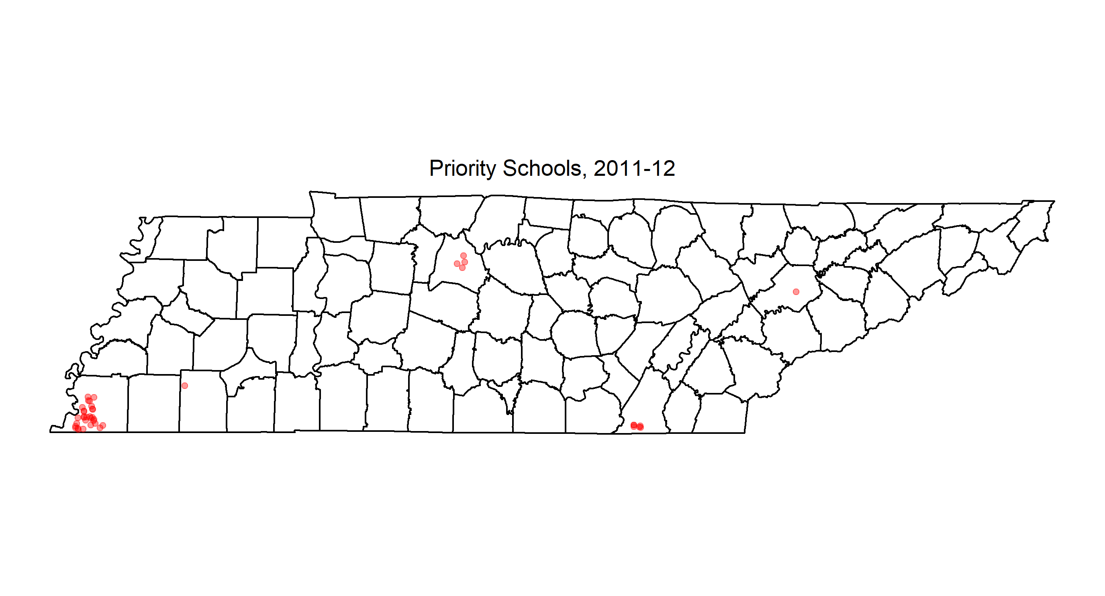
We first identified 83 Priority schools in 2012.

Slide 3

We identified 85 Priority schools in 2014.

Slide 4

4 of these schools exited in 2015.

Slide 5

Between closures and exits, only 56 schools were identified as Priority in 2017.

Slide 6
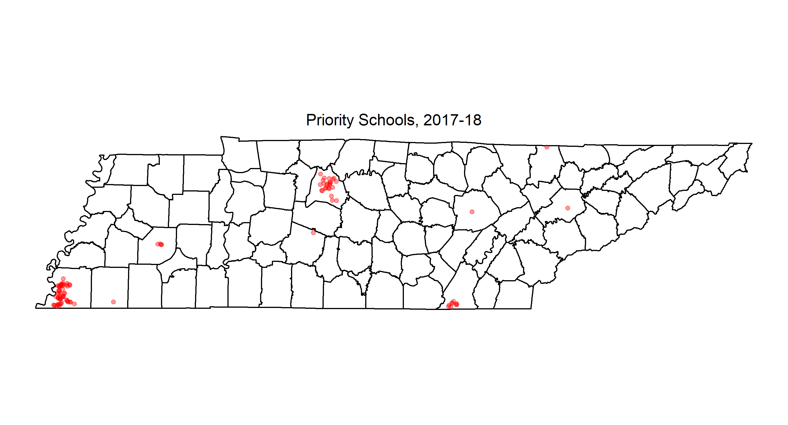
We identified 100 Priority schools in 2018, many more of which were in Nashville.

